Slide 1
IMAGE PROCESSING · MINI PROJECT
Concrete Crack Detection
Detecting structural cracks with traditional image processing — no deep learning — evaluated on 118 CrackForest images
Presented by Member 1 · Member 2 · Member 3
Notes:
[Member 1] Hello, today we present our project: Concrete Crack Detection using traditional image processing.

Slide 2
Problem & Motivation
Why automatic crack detection matters
Last year's earthquake affecting Thailand put the safety of buildings and infrastructure in focus. Cracks on concrete walls and columns are one of the earliest warning signs of structural deterioration.
Manual inspection is slow
Large or hard-to-reach areas take time and cost
1
Results vary by inspector
Accuracy depends on individual experience
2
Needs a screening aid
Let the computer flag where to re-check
3
Notes:
[Member 1] Motivated by the earthquake; cracks are an early warning sign, but manual inspection is slow and inconsistent.

Slide 3
Objective & Scope
Objective Automatically detect cracks on concrete and separate real structural cracks from normal rough texture, pores, or stains.
Technique
Data
Traditional image processing only (OpenCV); no deep learning, to prove the underlying math
CrackForest, 118 images 480×320 with pixel-level ground truth (converted from .mat to PNG)
Task split
Out of scope
Member 1 image prep · Member 2 algorithm & tuning · Member 3 evaluation & summary
Severity grading, real-world width in mm, and real-time video processing
Notes:
[Member 1] Goal: separate real cracks from normal texture, using traditional IP only, tested on 118 CrackForest images.

Slide 4
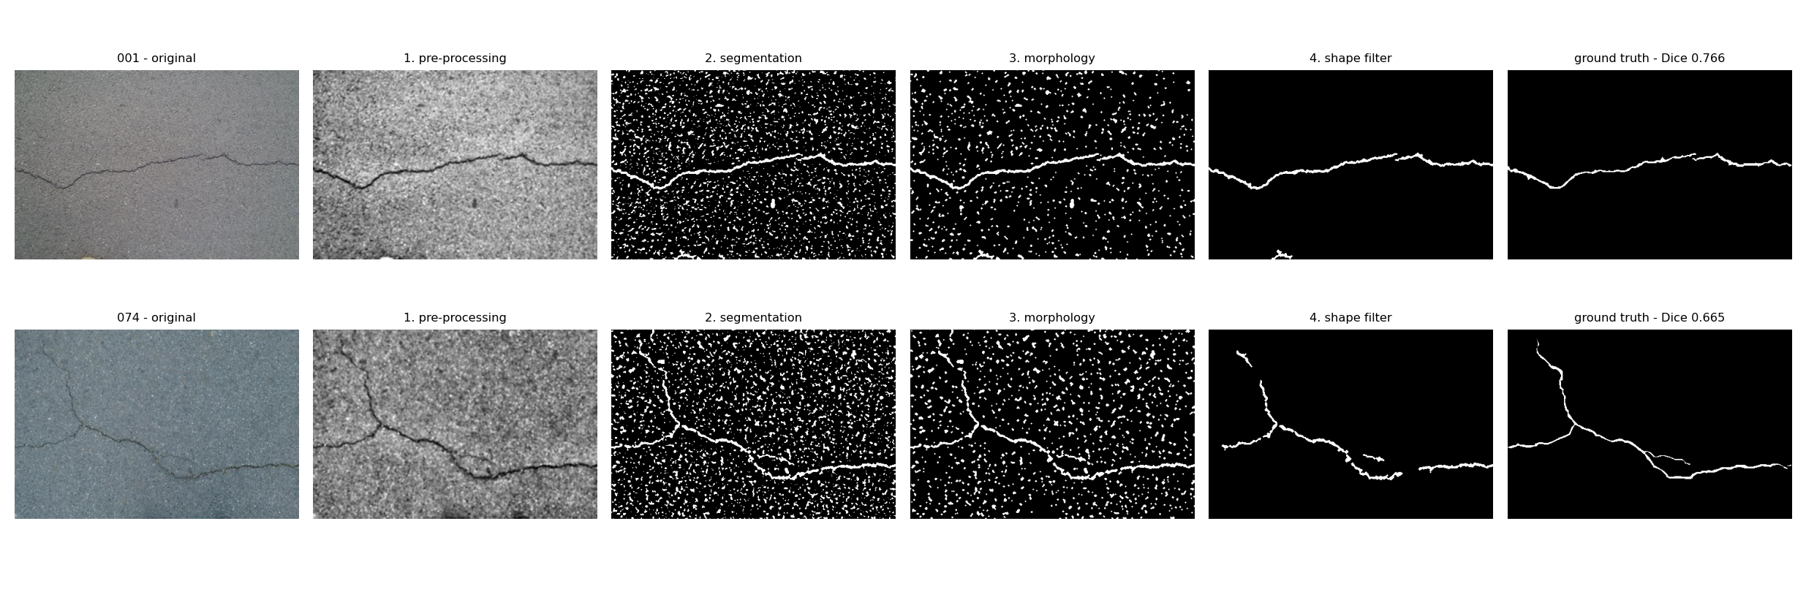
Pipeline Overview — 4 Steps
From a photo to a clean crack mask
Gray → contrast → Adaptive Threshold (still noisy) → Morphology → shape filter → final, vs. ground truth
Figure 1 — output of each step (image 001 top row, 074 bottom row)
Notes:
[Member 2] Four-step pipeline; steps 3-4 mainly clean up the noise that step 2 picks up.

Slide 5
The Four Steps
1
2
3
4
Pre-processing
Segmentation
Morphological
Shape Analysis
Grayscale, Gaussian blur, CLAHE contrast so dark cracks stand out
Adaptive Threshold compares each pixel to its neighbourhood; robust to uneven light
Closing reconnects broken cracks; Opening removes small noise
Filter by area + circularity; keep thin lines, drop round blobs
All parameters come from grid search, not guesswork (stored in outputs/tuned_params.json)
Notes:
[Member 2] Walk through each step: pre-processing, adaptive threshold, morphology, shape analysis. Parameters from grid search.

Slide 6
Trustworthy Evaluation
Measured per pixel, with a separate train / test split
Train / held-out split
Parameters fitted on 59 images, then scored on 59 unseen images. The gap is only 0.001
1
Pick good AND stable
Split the training set into 5 folds and choose the max of (mean − std) to avoid flukes
2
Not Accuracy
Cracks are only 2.29% of pixels; predicting "no crack" already scores 0.977 — use IoU and Dice
3
Notes:
[Member 3] Pixel-level evaluation, separate train/test, and no accuracy because the data is imbalanced.

Slide 7
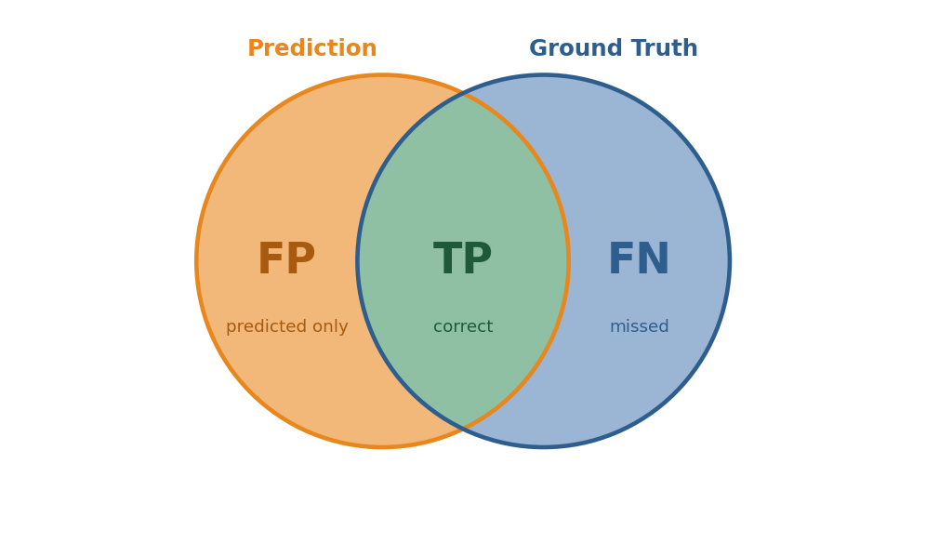
The Metrics
Measured per pixel: predicted mask vs. ground truth
Precision
0.53
TP / (TP + FP)
Of predicted crack pixels, how many are correct (cuts false alarms)
Recall
0.57
TP / (TP + FN)
Of real crack pixels, how many were found (cuts misses)
IoU
0.35
TP / (TP + FP + FN)
Overlap of the two areas · the segmentation standard
TP correct FP over-predicted FN missed
Dice (F1)
0.50
From 118 real images: TP 180,802 · FP 171,802 · FN 233,636
2·TP / (2·TP + FP + FN)
Harmonic mean of P & R · the headline number
Notes:
[Member 3] Explain the metrics: count TP/FP/FN per pixel. Precision = how much of what we predicted is right, Recall = how much of the real cracks we found, IoU/Dice combine both into one overlap score. Dice is the headline number.

Slide 8
Results
Mean pixel-level metrics over all 118 real images
Dice (F1)
IoU
Precision
Recall
0.5024
0.3533
0.5273
0.5732
from 0.3201
from 0.2051
from 0.2479
from 0.5982
Dice progression across tuning rounds
 | Baseline | Round 1 | Round 2 | Round 3
Precision | 0.2479 | 0.5349 | 0.4990 | 0.5273
Recall | 0.5982 | 0.5194 | 0.5781 | 0.5732
IoU | 0.2051 | 0.3399 | 0.3492 | 0.3533
Dice | 0.3201 | 0.4872 | 0.4991 | 0.5024
Precision more than doubled — the system stopped calling plain texture a crack, while Recall barely dropped
Notes:
[Member 3] Headline Dice 0.5024 from 0.3201; the big change is precision more than doubling.

Slide 9
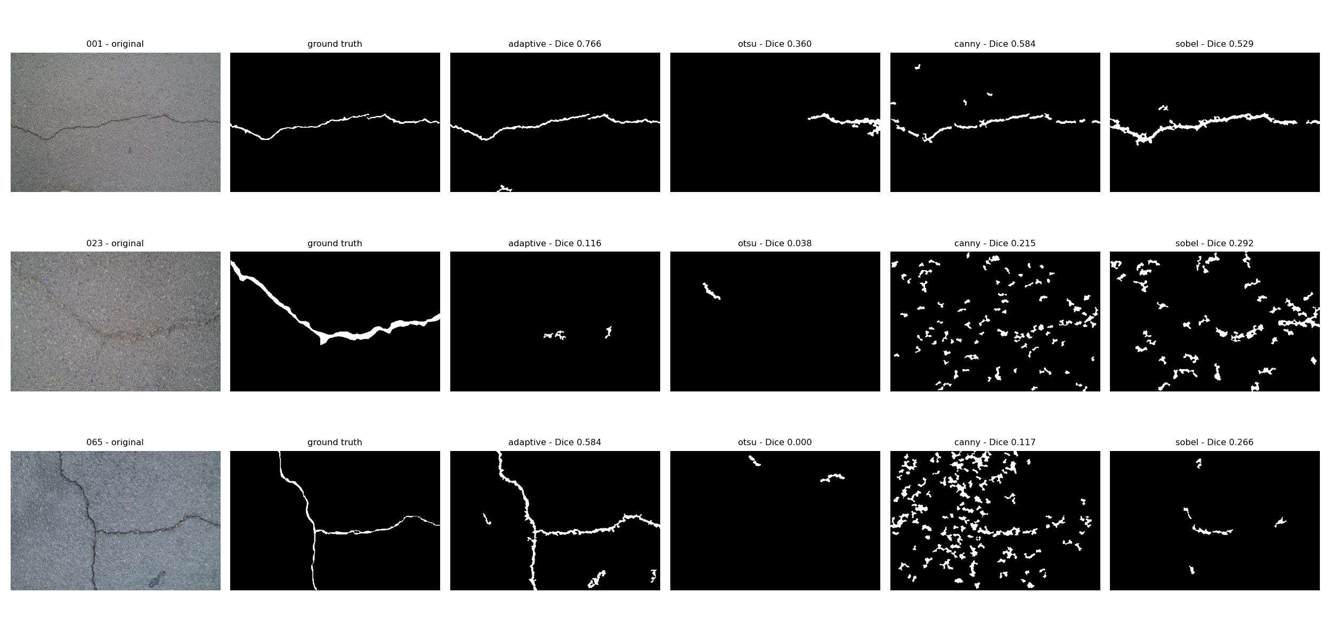
Compared to Other Methods
Every method tuned the same way, all four steps active
Method | Dice (held-out) | Dice (118) | Wins | False Pos.
Adaptive | 0.5105 | 0.5024 | 102 | 171,802
Sobel | 0.3159 | 0.2927 | 8 | 463,628
Otsu | 0.2257 | 0.2428 | 5 | 392,289
Canny | 0.2237 | 0.2107 | 3 | 1,457,995
Canny & Sobel respond to sudden brightness changes — everywhere on pavement from asphalt texture, stain edges and shadows. Otsu uses one global threshold, so it grabs shadows as cracks. Adaptive asks the more specific question: is this pixel darker than its neighbours?
Figure 2 — masks from each method on the same image
Notes:
[Member 3] Adaptive beats the others on 102/118 images because edge and Otsu are fooled by texture and shadows.

Slide 10
Key Lesson
The old shape criterion (aspect ratio) made results worse
Aspect ratio of the bounding box assumes a crack is straight — a T-shaped or branching crack has a near-square box and gets discarded whole.
circularity (new)
0.5243
no shape filter
0.5201
both criteria
0.5030
Circularity = 4·π·area / perimeter² does not depend on curvature, so thin cracks pass however much they bend. Images that scored 0.0000 came back to 0.58.
aspect ratio (old)
0.4997
Best Dice on training images. The old criterion (0.4997) is worse than no shape filter (0.5201) — the new one (0.5243) is the first to justify this step.
Notes:
[Member 2] Lesson: the old aspect-ratio criterion discarded curved cracks; switching to circularity clearly helped.

Slide 11
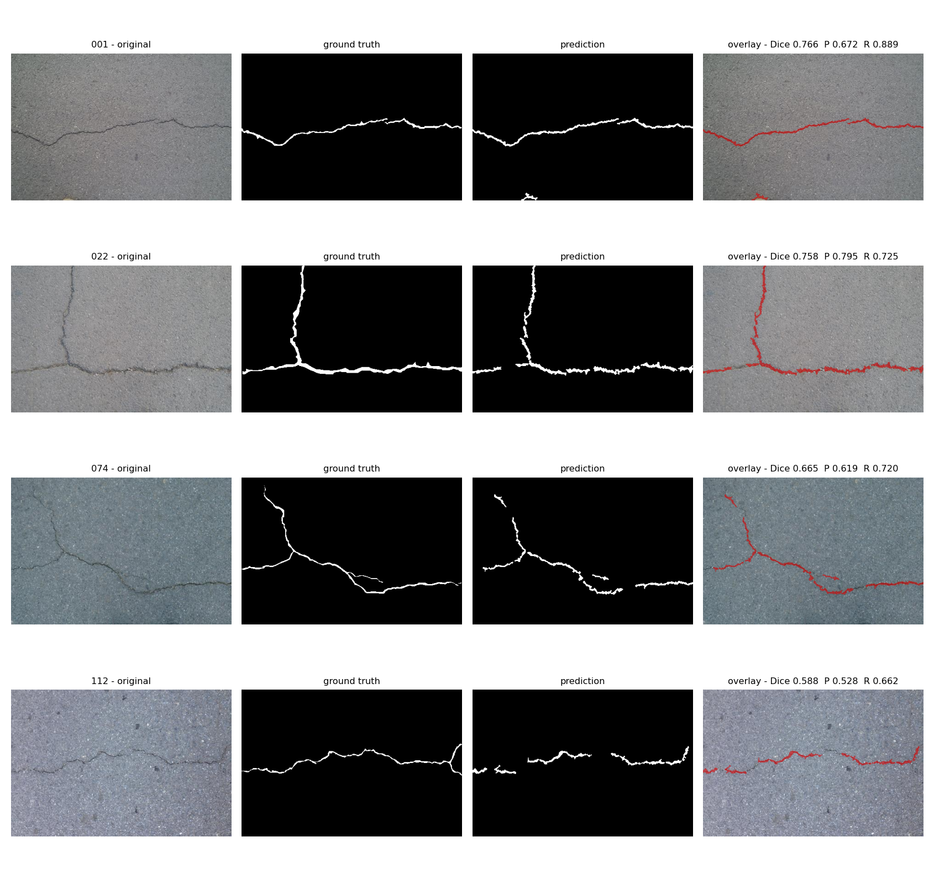
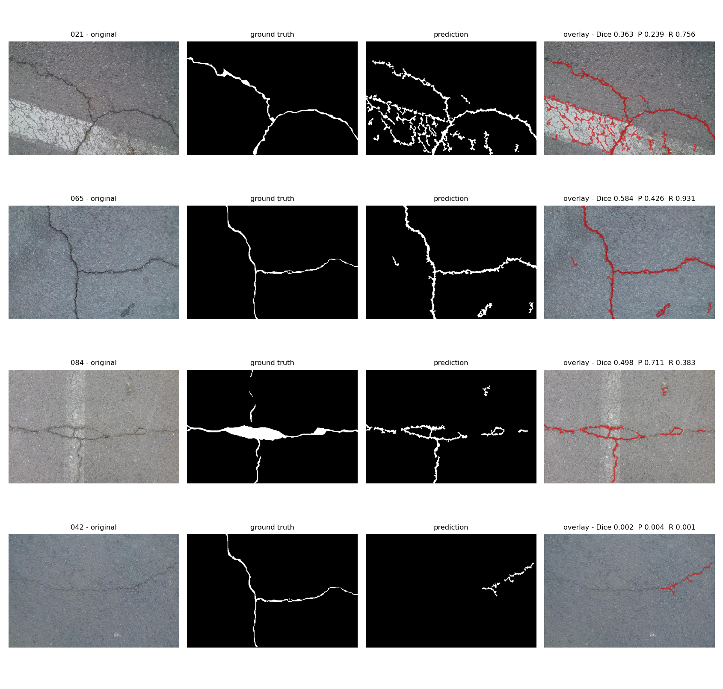
Example Results
original · ground truth · prediction · overlay
Works well — clear crack contrast and a uniform background
Low scores — some are ground-truth issues, not detection errors
Image 021: the system finds real crazing on the painted lane line that CrackForest did not annotate → a pixel metric punishes finding what the annotator did not draw
Notes:
[Member 3] Good and failing cases; some failures are ground-truth issues, not the system's fault.

Slide 12
Future Work & Conclusion
The pipeline runs at 7.0 ms/image (143 img/s) — light enough for small hardware
1
2
3
4
Embed Edge AI
Improve step 4
Real width
Test indoor concrete
Optimize to run on ESP32/FPGA with inspection drones
It still discards 20.2% of found crack pixels — recoverable
Convert to millimetres to grade crack severity
Current data is road surface, harder than the brief
In short: systematically tuned traditional image processing reaches Dice 0.5024 on real images, and Adaptive Threshold beats Otsu/Canny/Sobel on 102 of 118 images.
Thank you
Notes:
[Member 1] Future work toward Edge AI / drones; the pipeline is fast enough. Conclusion and thanks.

